Slide 1

PHYS1291
Fundamentals of Engineering Physics
Unit V: Fibre optics
Dr.B.SrinivasaRao,
Department of Physics, Gitam School of Science
GITAM (Deemed to be University)

Slide 2
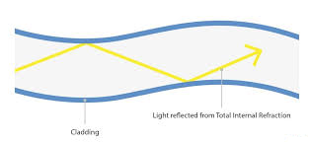
Introduction
Fiber optics deals with the light propagation through thin glass fibers.
The Basic principle of optical fiber
Principle: The basic principle of optical fiber in the transmission of optical signal is total internal reflection.
Total internal reflection
When the light ray travels from denser medium to rarer medium the refracted ray bends away from the normal. When the angle of incidence is greater than the critical angle, the refracted ray again reflects into the same medium. This phenomenon is called total internal reflection.

Slide 3
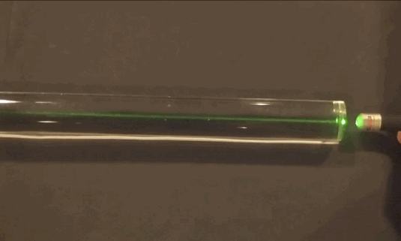

Slide 4
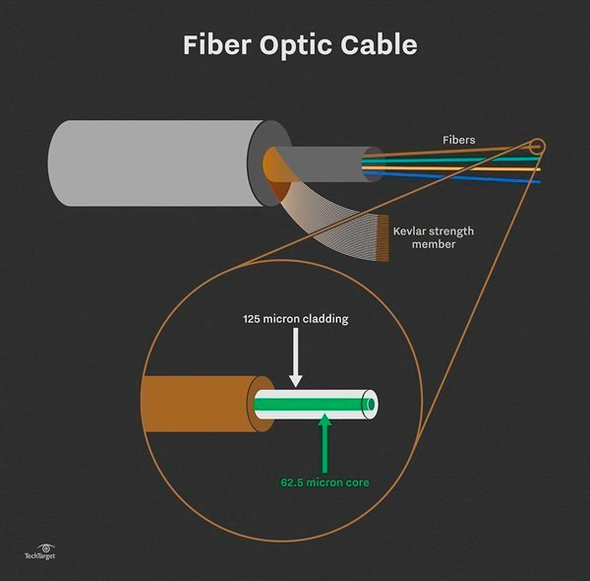

Slide 5
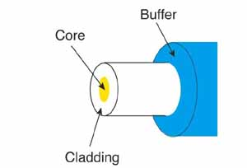
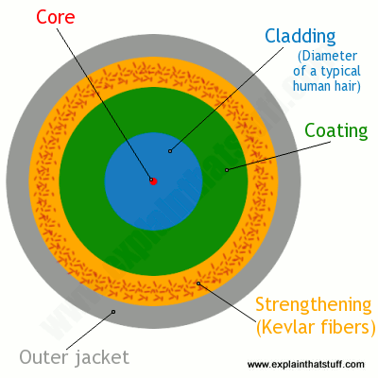

Slide 6
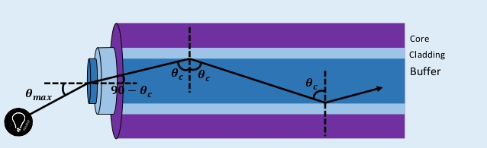

Slide 7
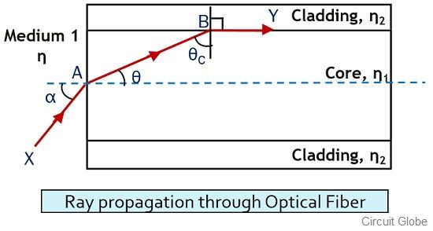
Derivation for Numerical Aperture of Optical Fiber

Slide 8

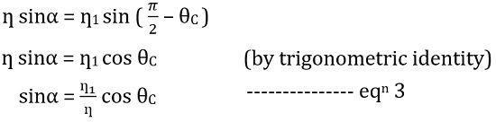

Slide 9
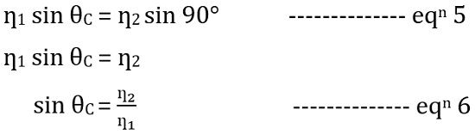


Slide 10
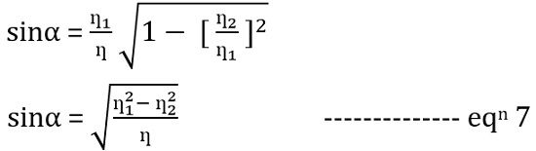


Slide 11
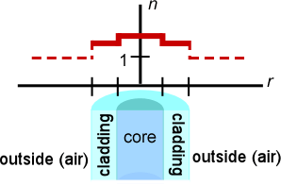

Step-Index Fiber
a step-index profile is a refractive index profile characterized by a uniform refractive index within the core and a sharp decrease in refractive index at the core-cladding interface so that the cladding is of a lower refractive index. The step-index profile corresponds to a power-law index profile with the profile parameter approaching infinity.

Slide 12
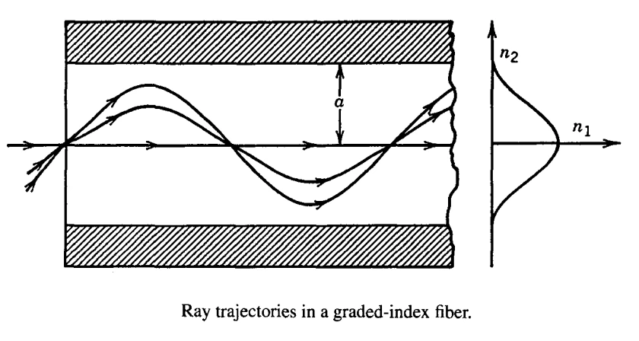
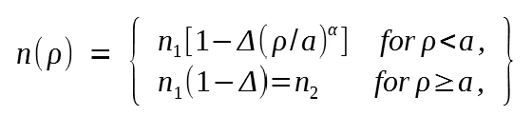
Graded-Index Fiber
a graded index is an optical fiber whose core has a refractive index that decreases with increasing radial distance from the optical axis of the fiber.
Because parts of the core closer to the fiber axis have a higher refractive index than the parts near the cladding, light rays follow sinusoidal paths down the fiber. The most common refractive index profile for a graded-index fiber is very nearly parabolic. The parabolic profile results in continual refocusing of the rays in the core, and minimizes modal dispersion.

Slide 13
let n = 1, n₁ = 1.46 and n₂ = 1.45 of core and cladding of an optical fiber system above. Find
a) the critical angle θ_{c} at the core - cladding interface.
b) the numerical aperture N.A. of the optical fiber
c) the angle of acceptance α_{max} of the the optical fiber system.

Slide 14
Find n₁ and n₂ such that the acceptance α_{max} = 10° and the critical angle at the core - cladding interface θ_{c} = 82 ° .

Slide 15
A step-index fiber has a core index of refraction of n₁ = 1.425. The cut-off angle for light entering the fiber from air is found to be 8.50º. (a) What is the numerical aperture of the fiber? (b) What is the index of refraction of the cladding of this fiber? (c) If the fiber were submersed in water, what would be the new numerical aperture and cut-off angle?
NA = n₀ sin θ_{0max}
n₂² = n₁² - NA²
sin θ_{0max} = NA/n₀
Find the acceptance angle of a material which has a numerical aperture of 0.707 in air.

Slide 16
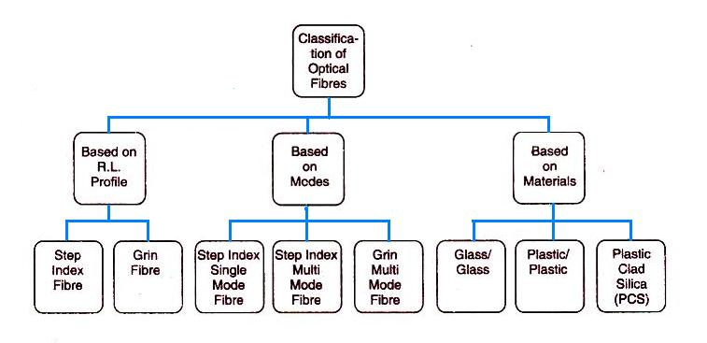
Classification of optical fiber

Slide 17
Classification of optical fibres based on modes
On the basis of mode transmission, the optical fibre is classified into two modes
Single mode
Multi mode

Slide 18
Single mode
• Supports only one mode of propagation
• It has small core diameter 2 to 8 μm
• Light is launched into single mode fibre by using laser diode
• Used for long distance communications; ex: telephone
• It has higher band width
• It is free from intermodal dispersion
• V number of single mode fiber V<2.405

Slide 19
Multi mode
• It supports more than one mode. It can propagate hundreds of modes
• The core diameter if of the order of 50 μm
• Light is launched into multimode fibre using LED
• Used for short distance communication; ex: LAN
• Band width is 6 to 50 km for multi mode step index fibre
• It suffer from inter modal dispersion
• V number of multi mode fiber V>2.405

Slide 20
Classification of fibres based on index profile
A fibre is characterized by its profile. The index profile is graphical representation of value of refractive index across the core diameter
Step index
Graded index

Slide 21
Based on refractive index and modes of fiber there are three different configurations
Single mode step index fibre:
• There is only one path for ray propagation
• Light is propagated in fibre through reflections
• Propagation corresponds to single ray path and is along fibers center line
• Core diameter is about 8 to 10 μm and cladding is 60 to 70 μm
• Lasers are used as light sources
• Uses in underwater cable systems
• NA is small

Slide 22
Multi mode step index fibre:
• Most widely used
• It contains several modes of propagation
• It has large relative refractive index difference
• NA is of order of 0.3
• Core and cladding diameters are much larger to have may paths that a light ray may
follow during propagation
• Light propagation is by multiple total internal reflections
• Core diameter varies from 50 to 200 μm and cladding varies from 100 to 250 μm
• Used in applications requiring distances less than 1 km

Slide 23
Graded index fibre:
• Light ray is propagated through refraction
• NA is smaller than step index multi mode fibre
• Light enters the fiber at many different angles
• The beam travelling at farthest distance will propagate at higher speed because it meets
lower refractive index.
• Core diameter varies from 50 to 200 μm and cladding varies from 100 to 250 μm
• Either laser or LED is used as light source
• Used for long distance communications

Slide 24
Materials are used to fabricate optical fibers
The materials used for fabrication of optical fibers are
Glass:
• The basic material is silica
• Materials with different refractive index are obtained by doping silica with small quantities
of various oxides
• SiO2 core- B2O3.SiO2 cladding
• GeO2.SiO2 core – SiO2 cladding
Plastic fibers:
• PMMA and polysterene are used for core
• Silicon resin or fluorocarbon polymer are used for cladding
• Plastic fibers have large NA of the order of 0.6
Plastic Clad Silica fibers:
• They are made of silica cores surrounded by a low refractive index transparent polymer as
cladding
• Core is made from high purity quartz and cladding is made of silicone resin

Slide 25
Advantages of optical fibres in communication systems
• Enormous potential bandwidth: The information carrying capacity of optical fiber systems is far superior than copper cable systems
• Small size and weight: They have diameters which are often no greater than diameter of human hair
• Electrical isolation: Optical fibers are fabricated from glass and plastics which are good electrical insulators
• Immunity to interference and cross talk. They are free from Electromagnetic interference (EMI) and radiofrequency interference (RFI)
• Signal security: The light from optical fiber does not radiate significantly and therefore provide a high degree of signal security
• Low transmission loss: Fibers have been fabricated with losses as low as 0.2 dB km-1
• Ruggedness and flexibility: Optical fibers are manufactured with high tensile strengths. They are superior in terms of storage, transportation handling etc
• Potential low lost: Optical fibers are made of SiO2 which is one of the most abundant materials on earth.

Slide 26
An optical fiber has a core with refractive index o f 1.52 and a cladding with index o f 1.45. Its numerical aperture is
Zircon has a refractive index o f 2.1. W hat is its critical angle for total internal reflection in air?

Slide 27

Fractional Refractive Index Change:
The fractional difference Δ between the refractive indices of the core and the cladding is known as the fractional refractive index change.
It is given by
The value of Δ is always positive because n₁ must be greater than n₂ for the total internal reflection condition.
In order to guide light rays effectively through a fibre, Δ<<1 and Δ is of the order of 0.01

Slide 28
A fibre cable has an acceptance angle of 30º and a core index of refraction of 1.4 Calculate the cladding refractive index
Calculate the fractional index change for a given optical fiber, if the refractive indices of the core and cladding are 1.563 and 1.498 respectively.
Calculate the refractive indices of the core and the cladding material of a fiber, if numerical aperture is 0.22 and fraction refractive index change is 0.012.

